Slide 1


Account Setup
(PC/Browser Version)

Slide 2

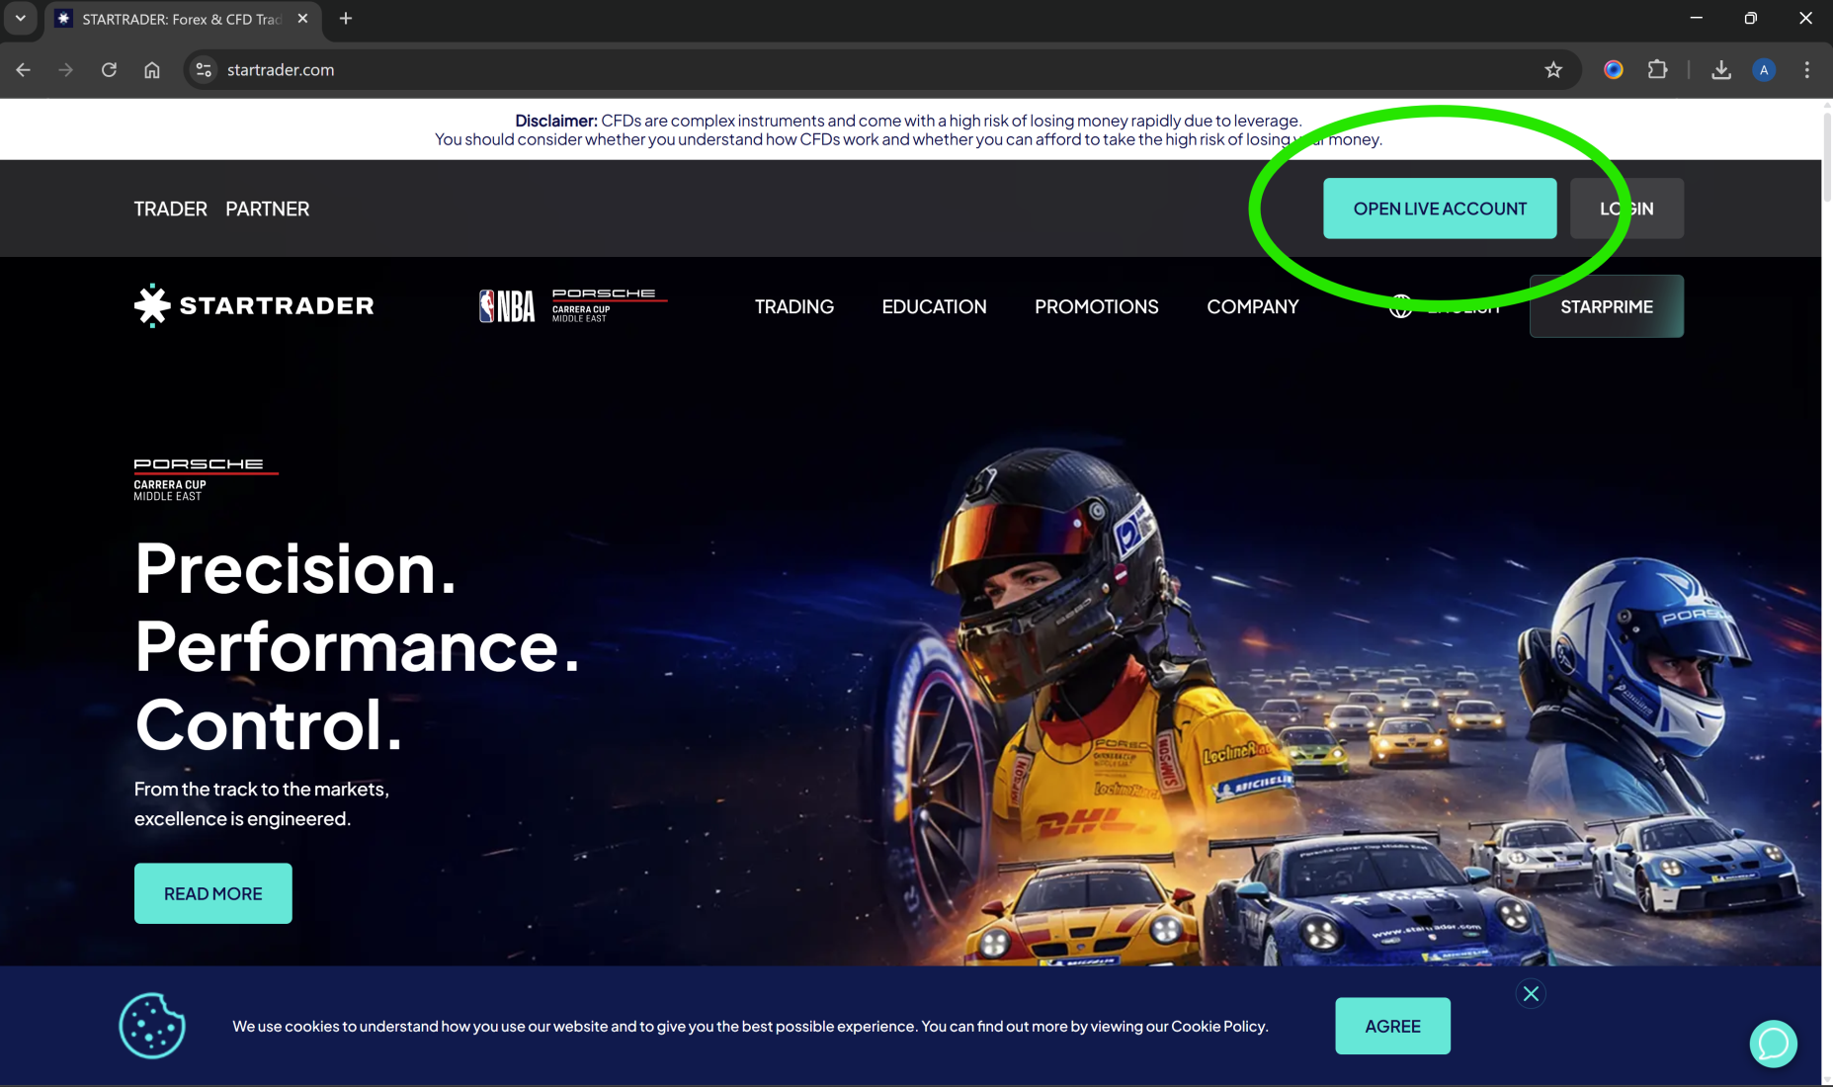
1. Get your referral link email from your affiliate ‘’OPEN LIVE ACCOUNT’’ (you require the unique link to sign up)

Slide 3
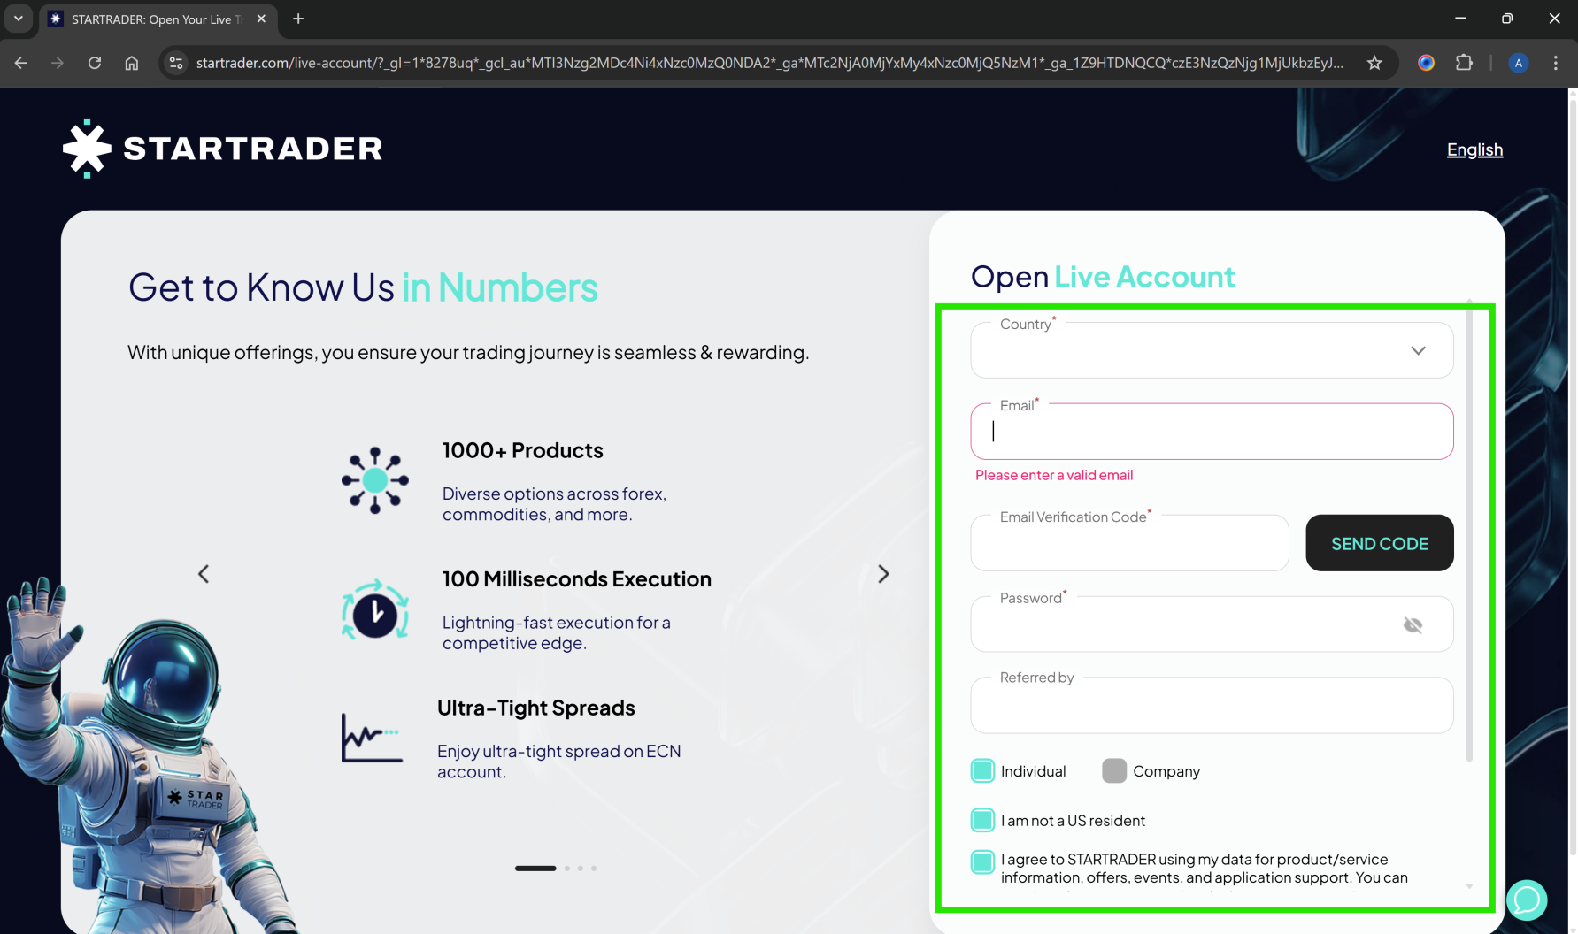
2. Place all your new login details below

Slide 4
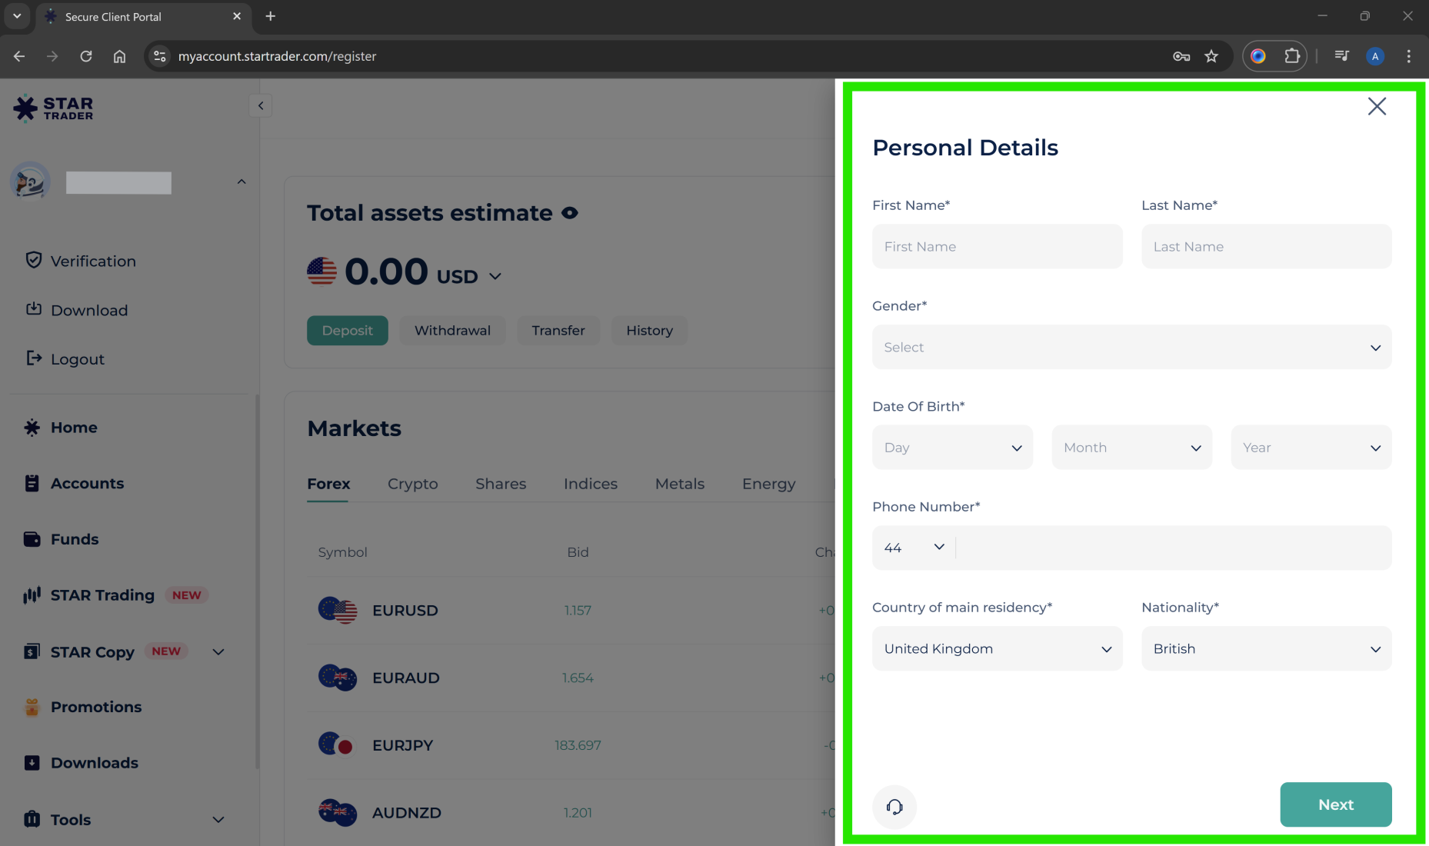
3. Place in all personal details

Slide 5
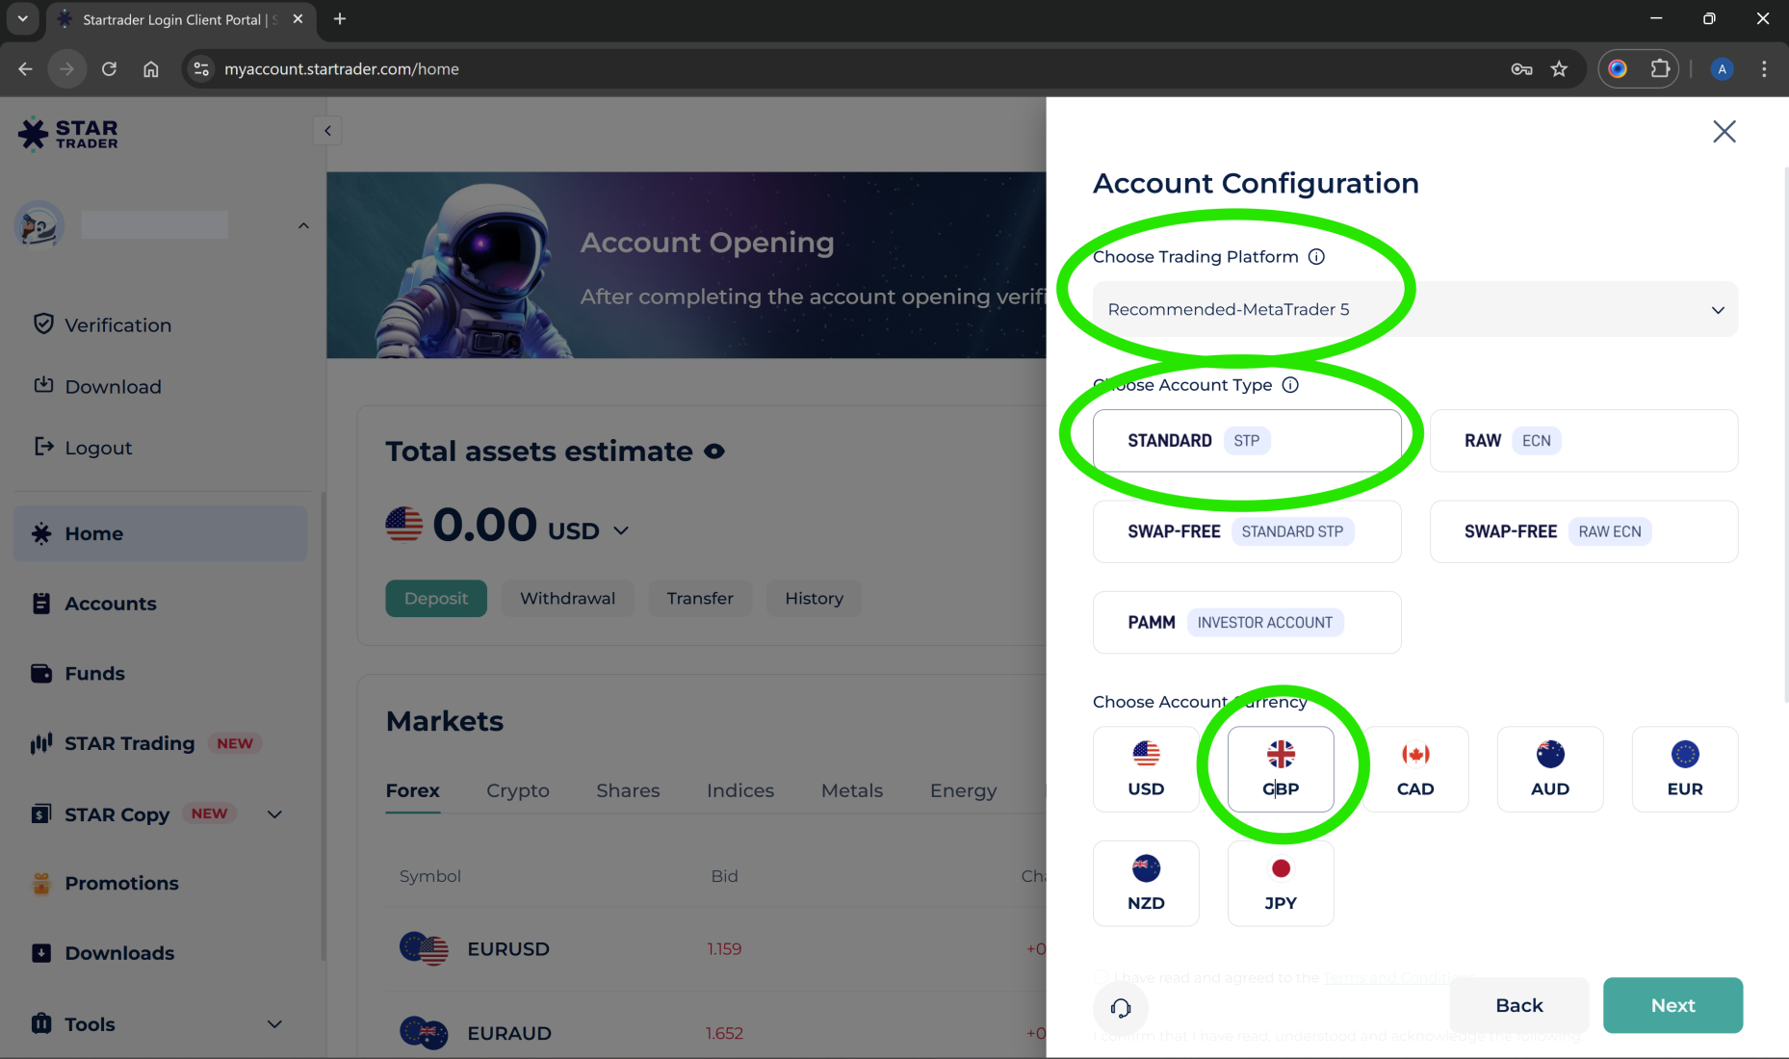
4. Select Recommended MetaTrader 5, Standard and GBP

Slide 6
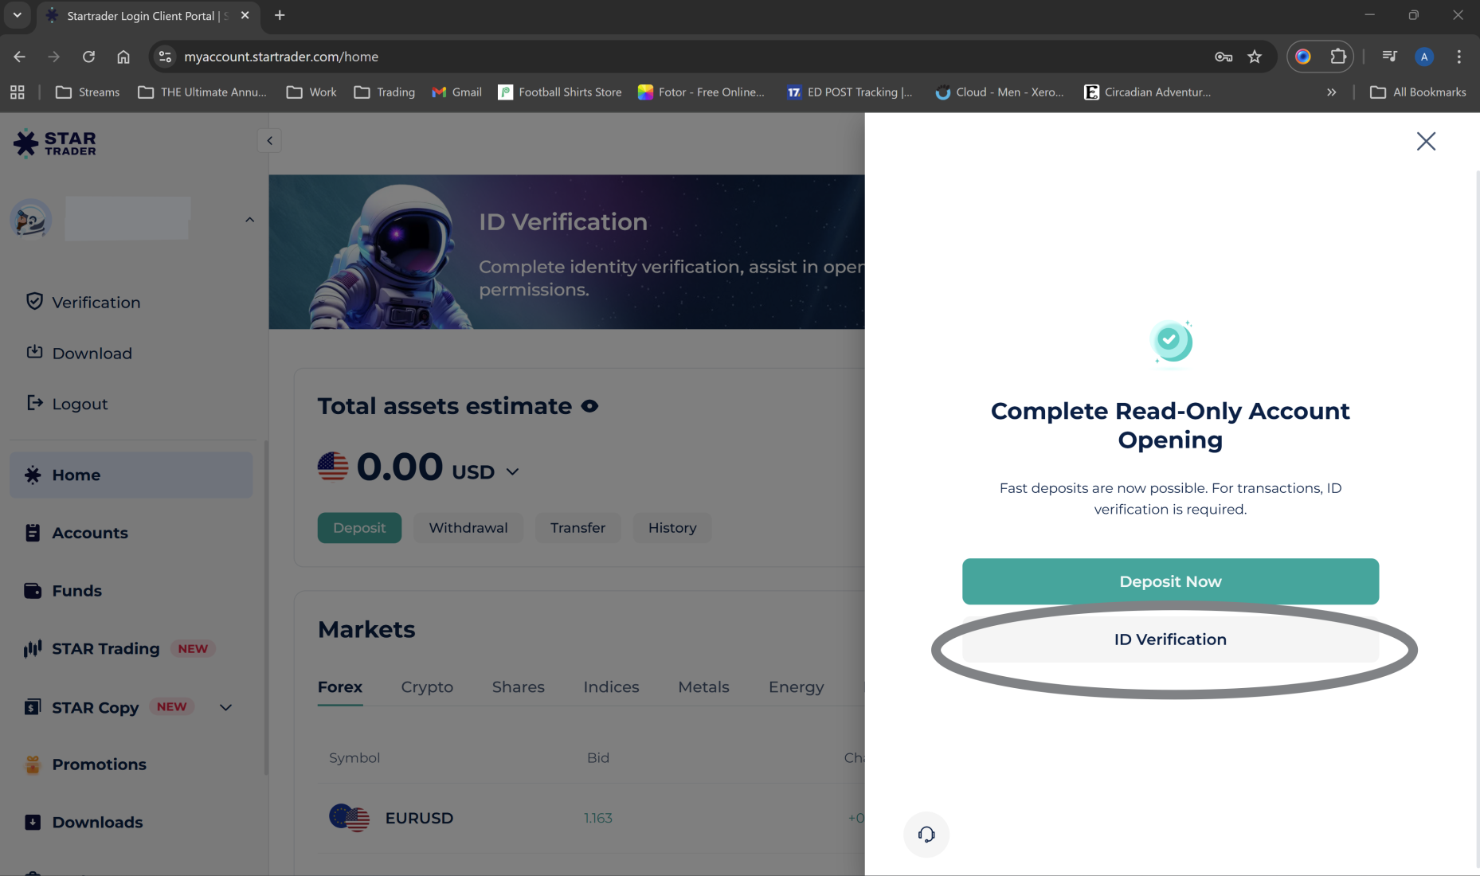
5. Do ID Verification

Slide 7
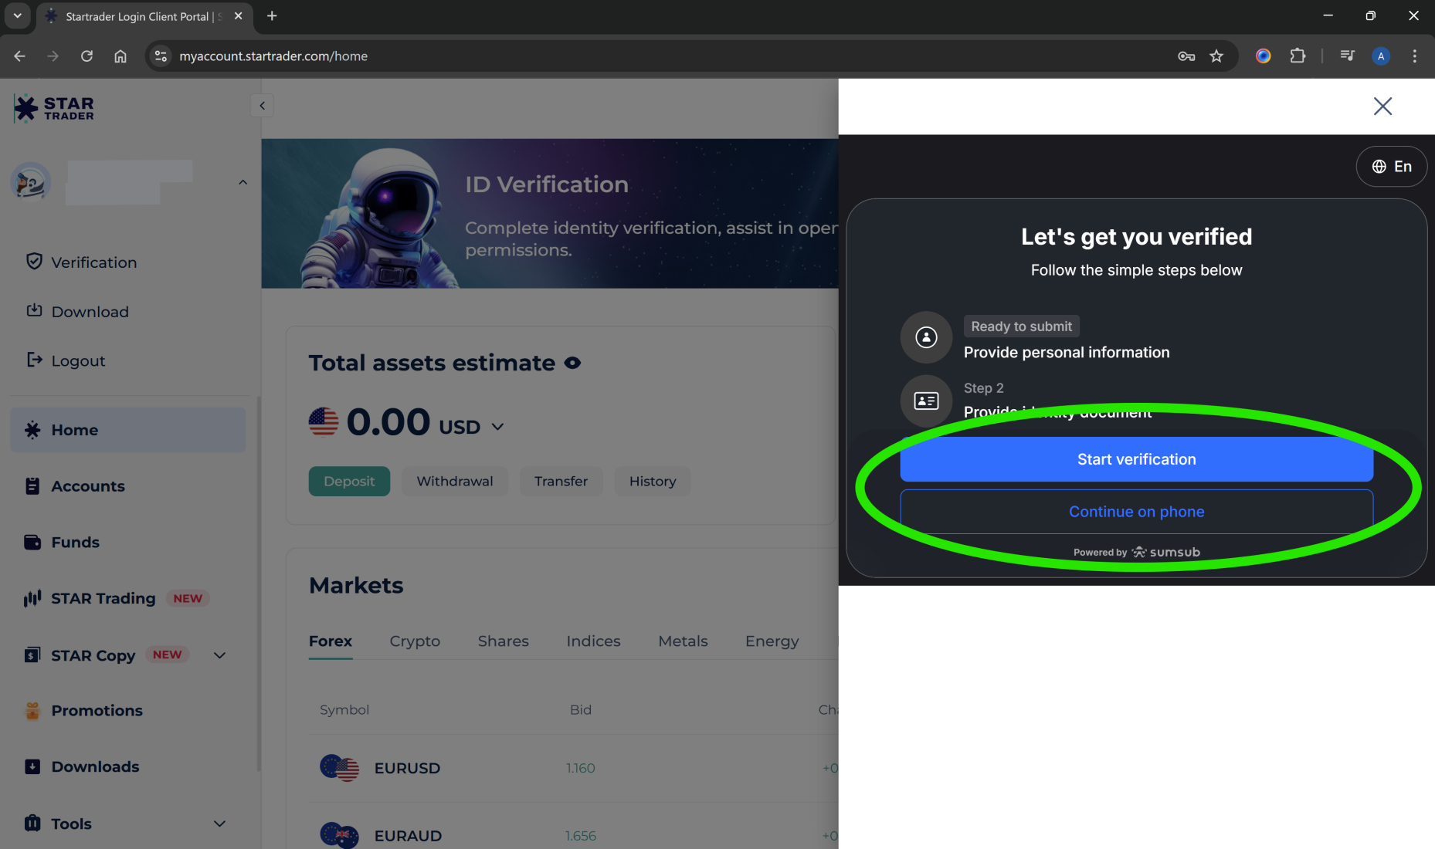
6. Start verification to continue on PC or Continue on phone if you want to update ID details on the STARTRADER app and choose ‘All other countries…’

Slide 8
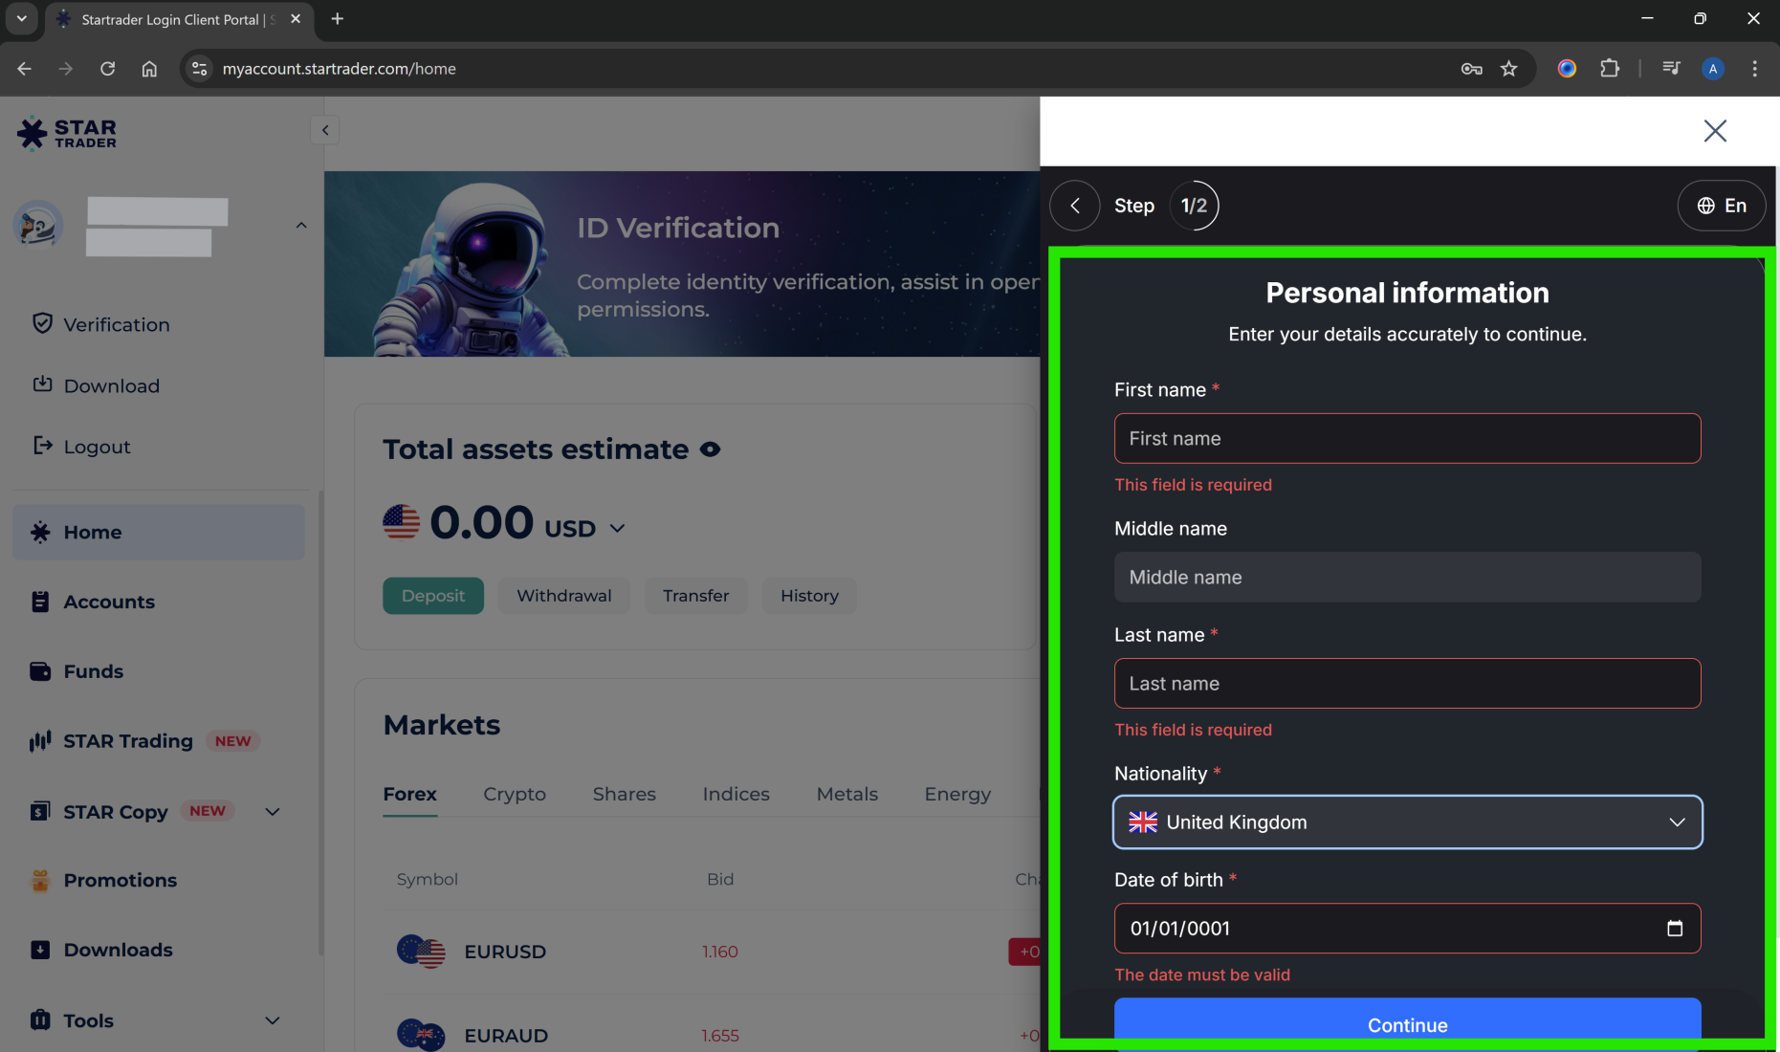
7. Place in all your details, choose which form of ID you would like to use to setup (passport, drivers licence etc.)

Slide 9
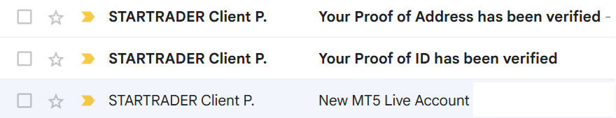
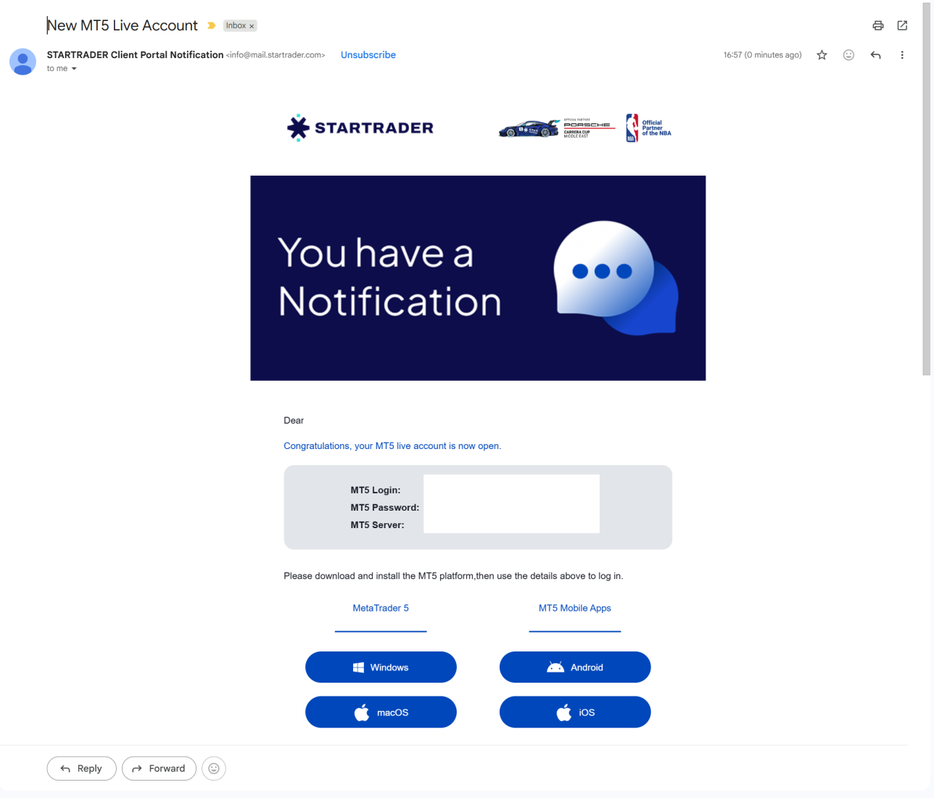
8. You will get an email with ‘New MT5 Live Account’, these login details need to be sent to your affiliate to get you linked to the software. You use these details to login to your MT5 account to monitor account progress

Slide 10
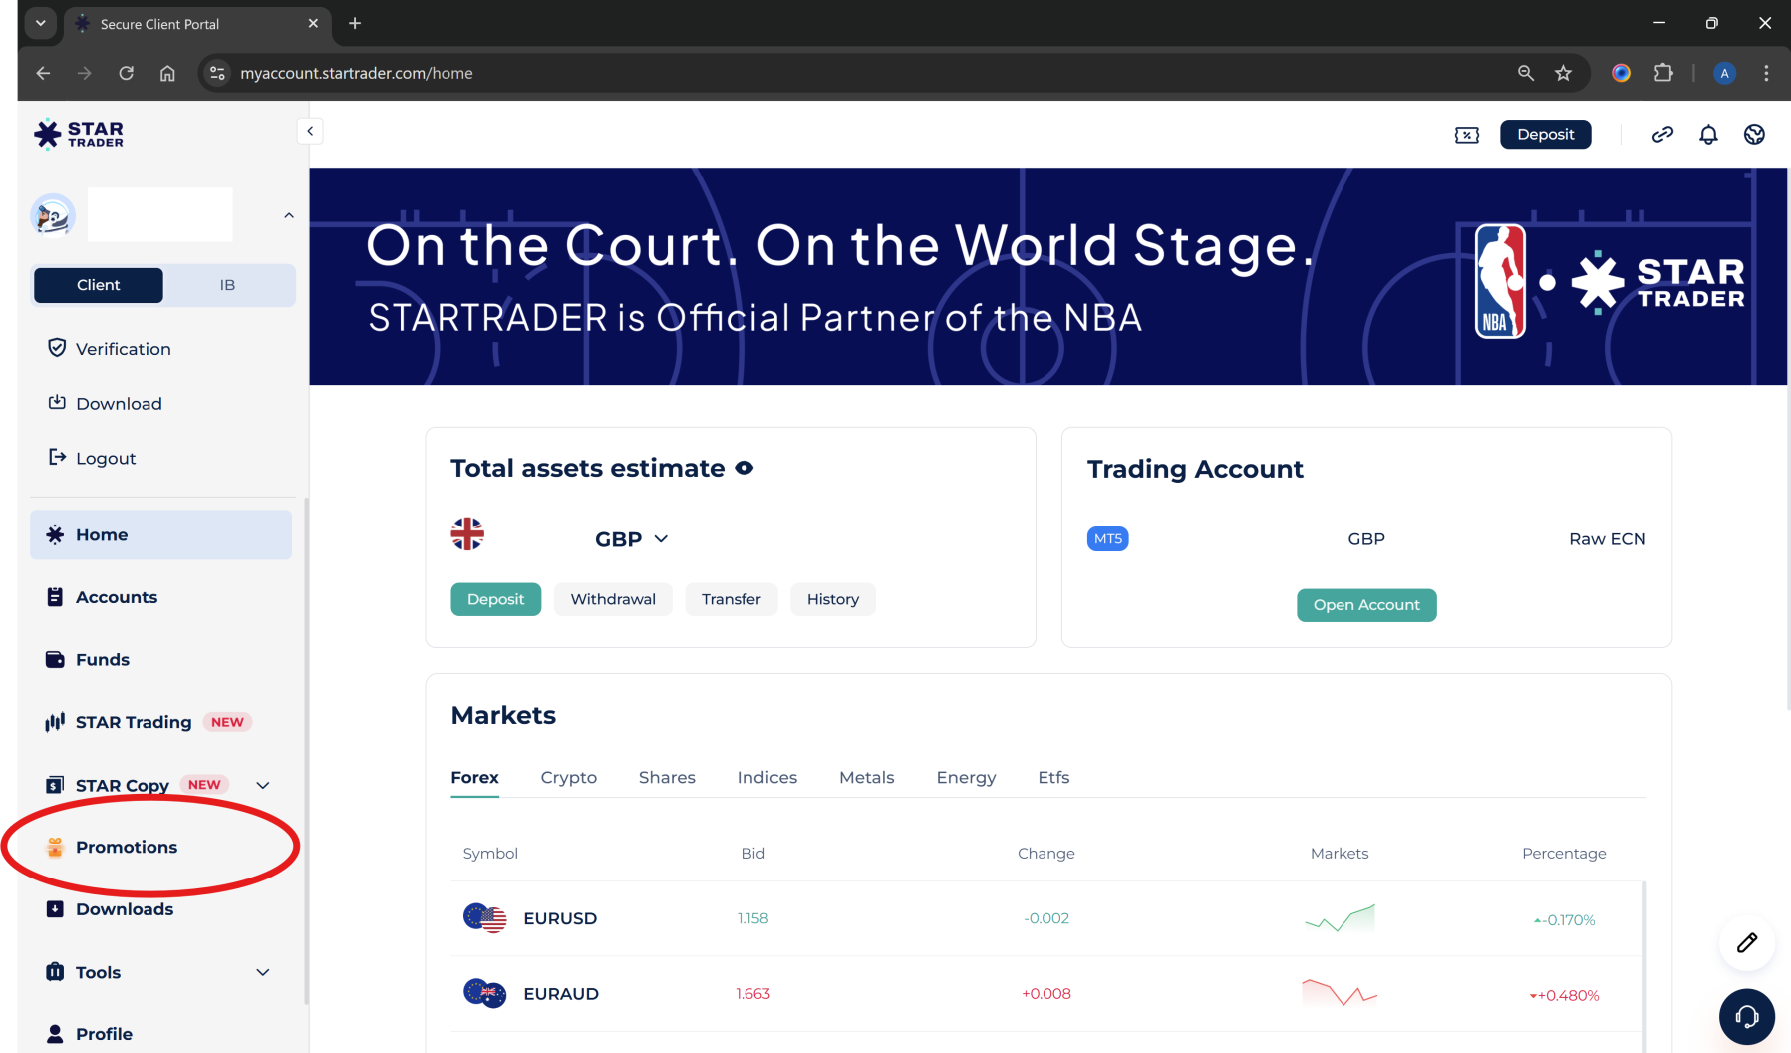
9. When your logged into your account, click on ‘Promotions’

Slide 11
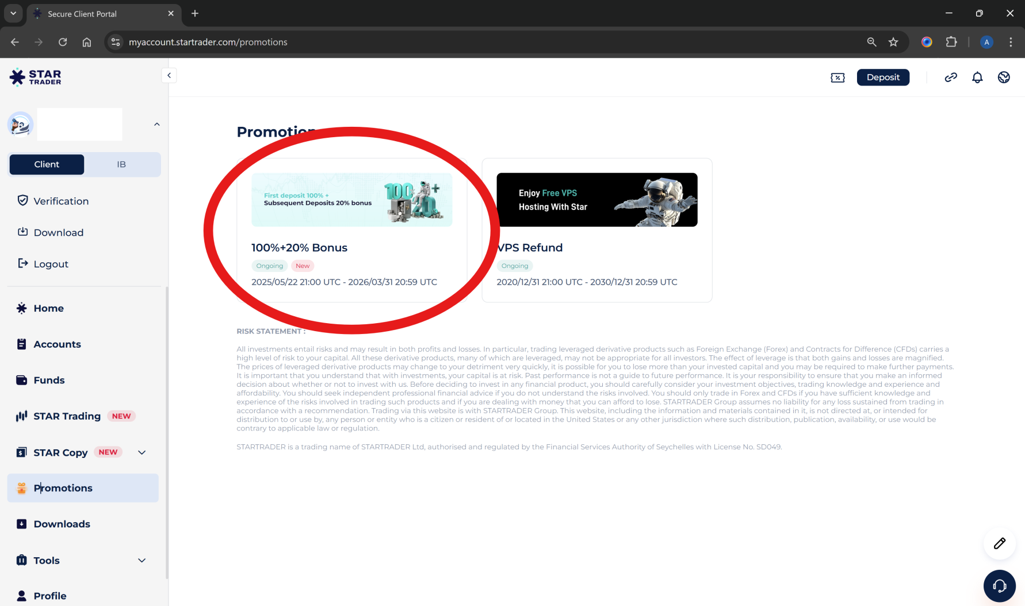
10. Click on 100%+20% Bonus

Slide 12
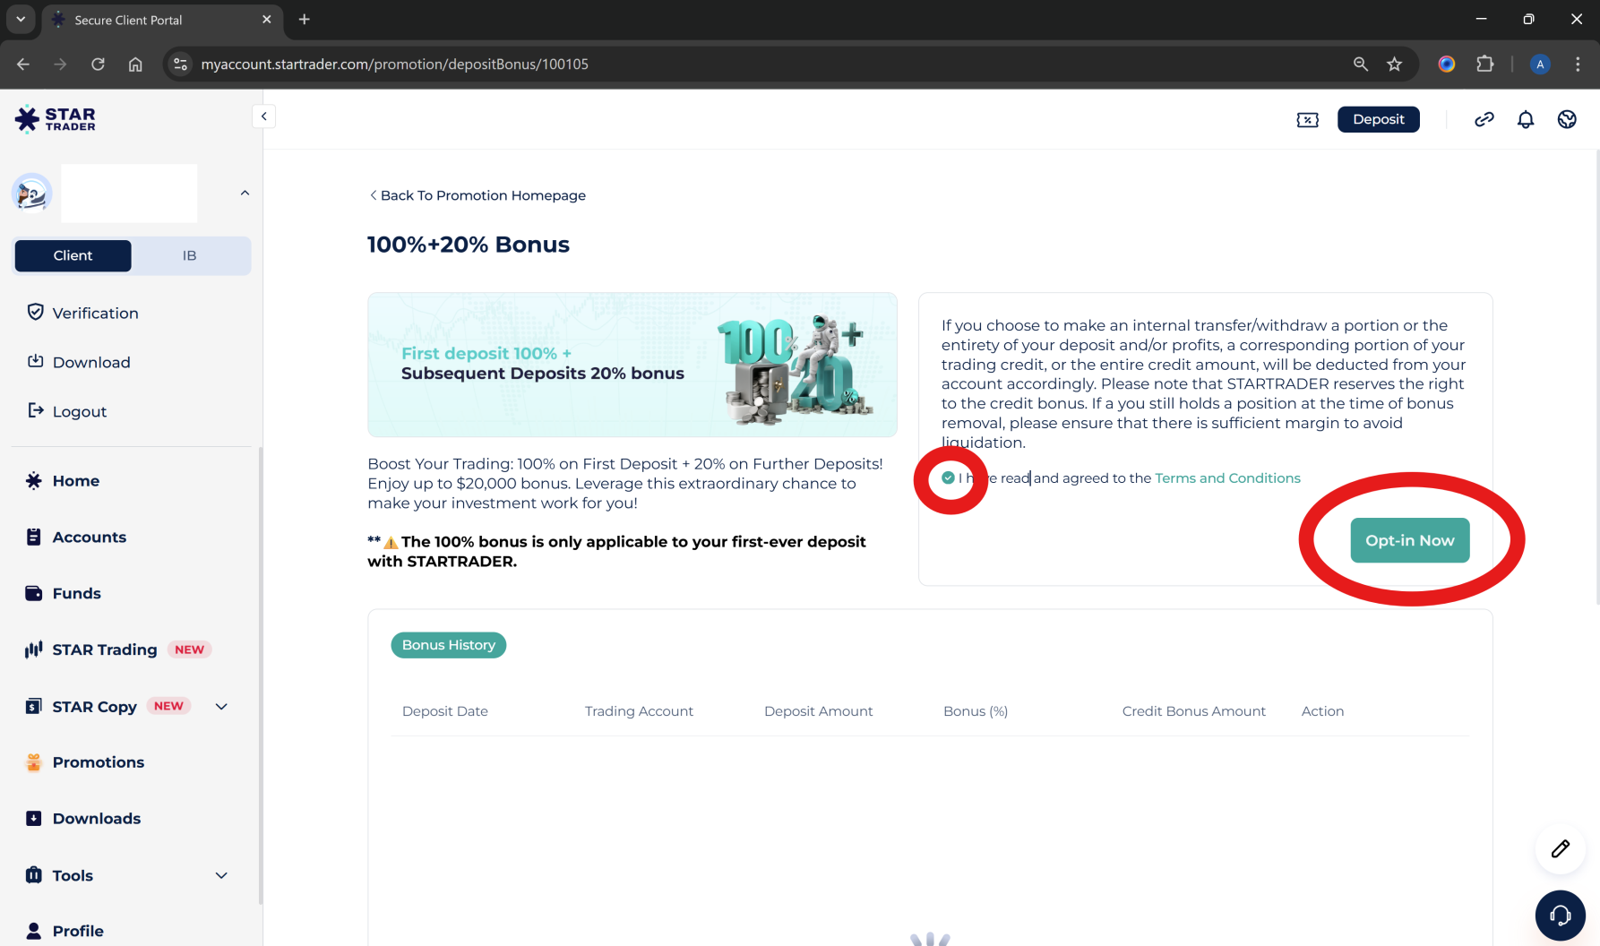
11. Agree terms and ‘Opt In Now’

Slide 13
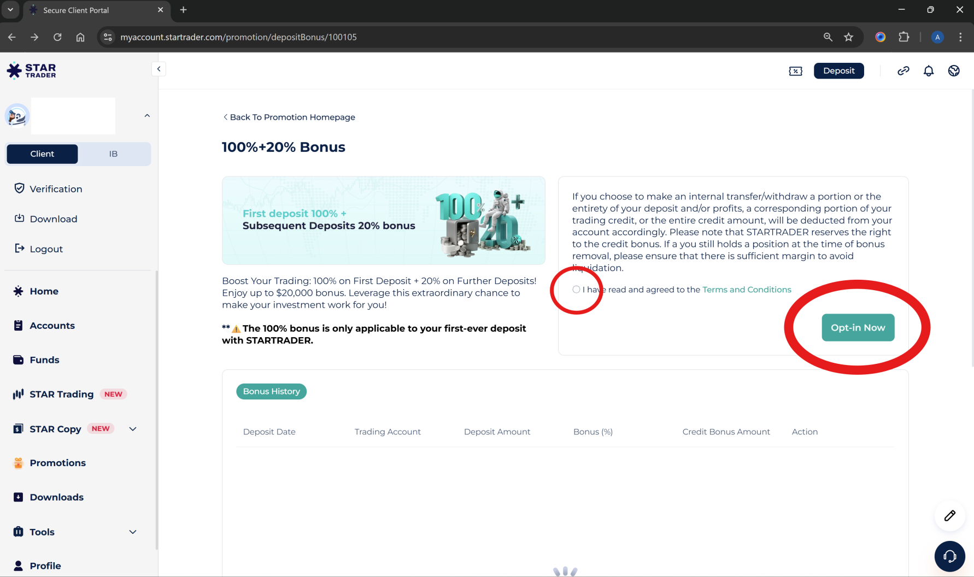
12. Agree terms and ‘Opt In Now’

Slide 14
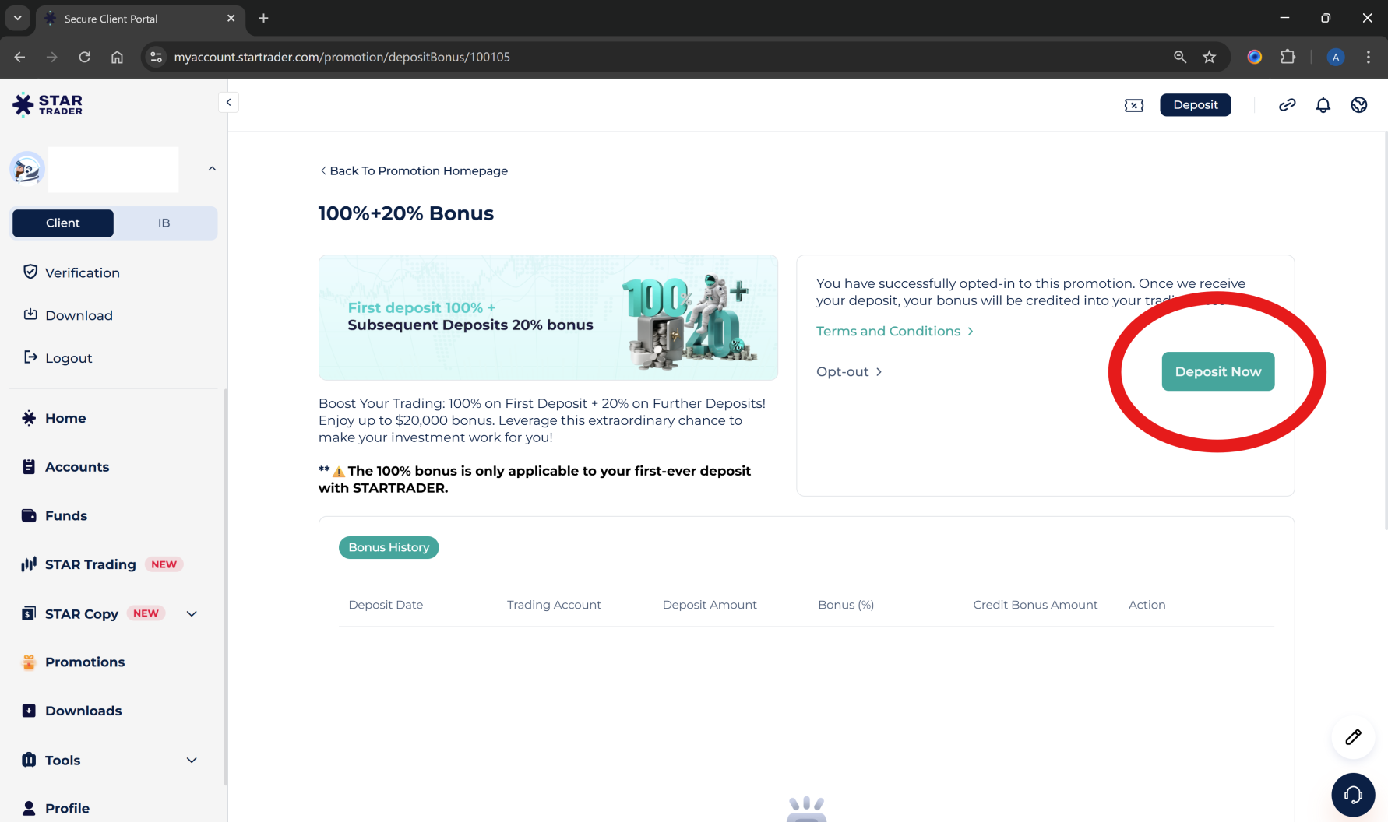
11. ‘Deposit Now’ and choose your method of payment. Once this is completed, message your affiliate who will confirm that everything is set up to link you to the software.

