Slide 1


Account Setup
(IPhone)

Slide 2

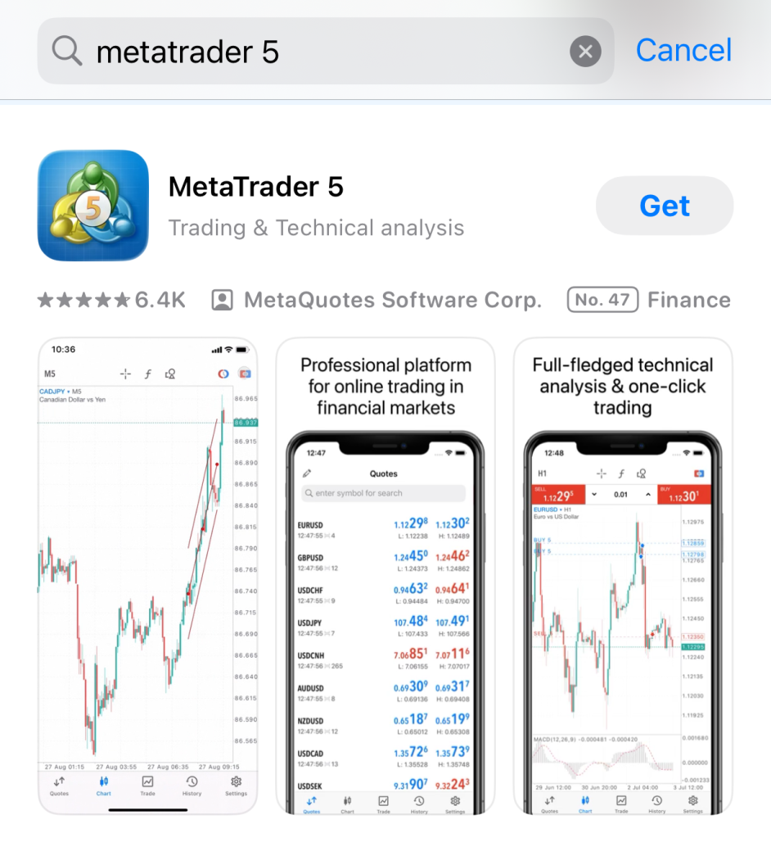
1. Download MetaTrader 5 App

Slide 3
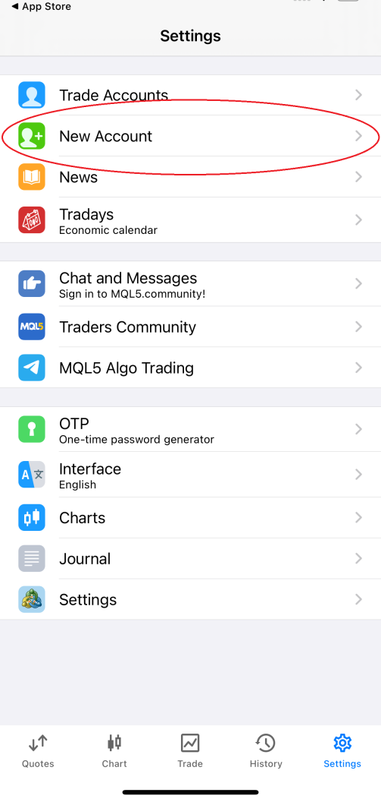
2. Click on settings in bottom right corner, then ‘’New Account’’

Slide 4
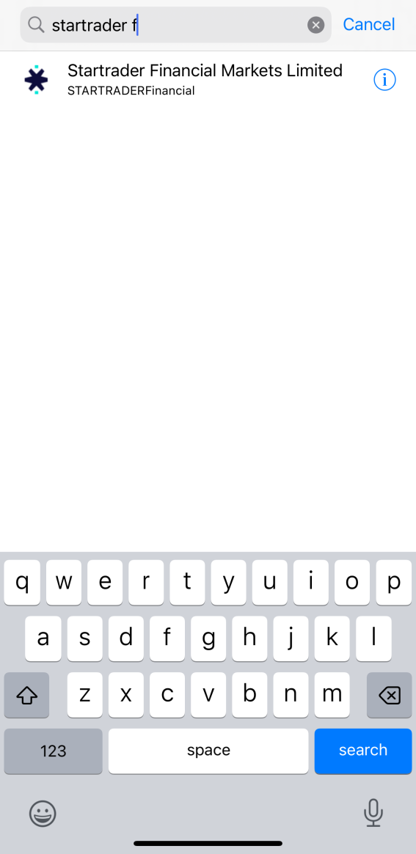
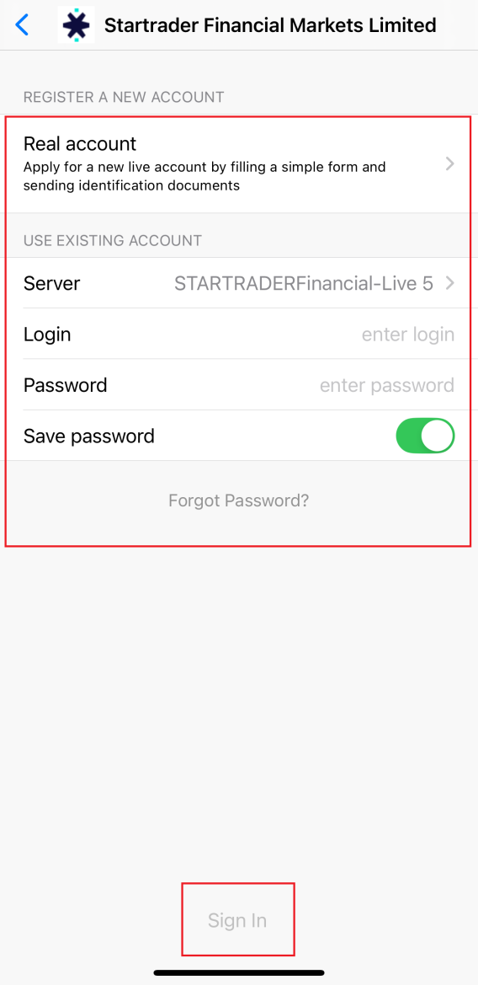
3. Type ‘Startrader Financial’ and click the broker below and place in your login details from the MT5 Login details email you received earlier and click ‘Sign In’

