Slide 1


Account Setup
(Android)

Slide 2

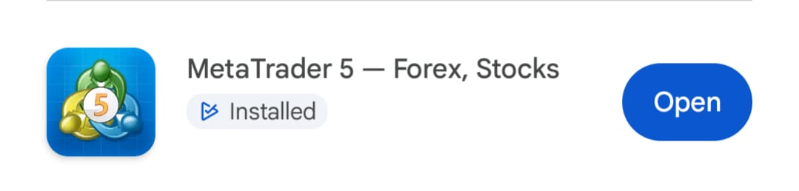
1. Download MetaTrader 5 App

Slide 3
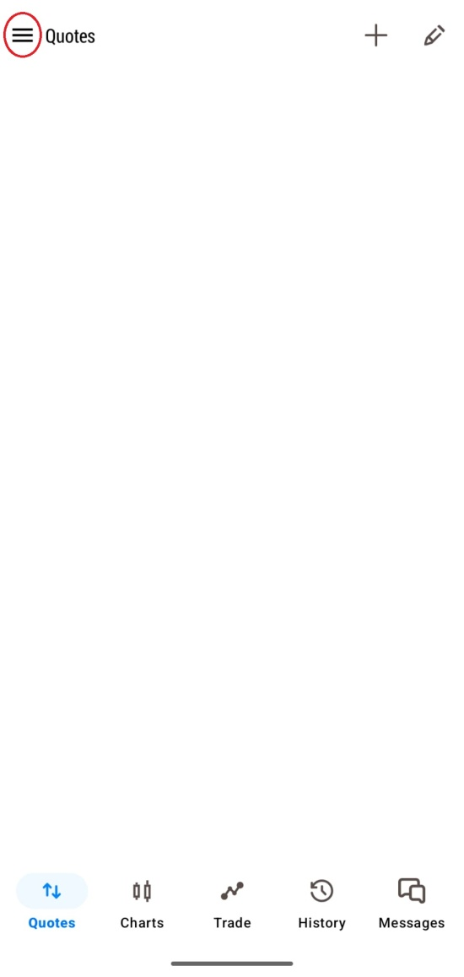
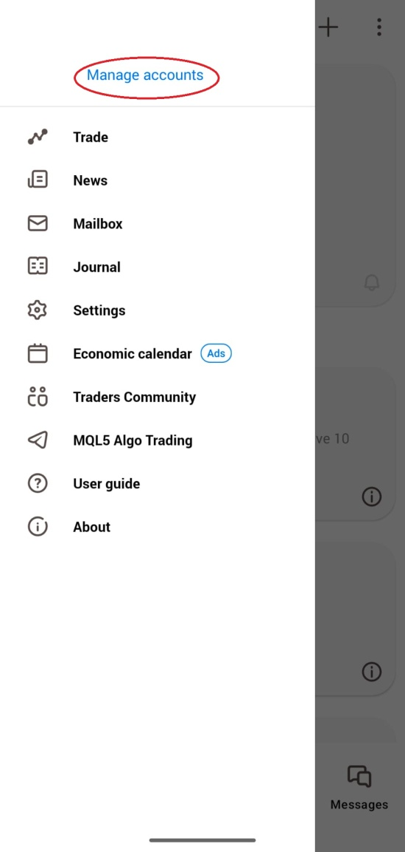
2. Click ‘’Quotes’’ at the bottom then click the top left hand corner the 3 lines icon and select ‘’Manage accounts’’

Slide 4
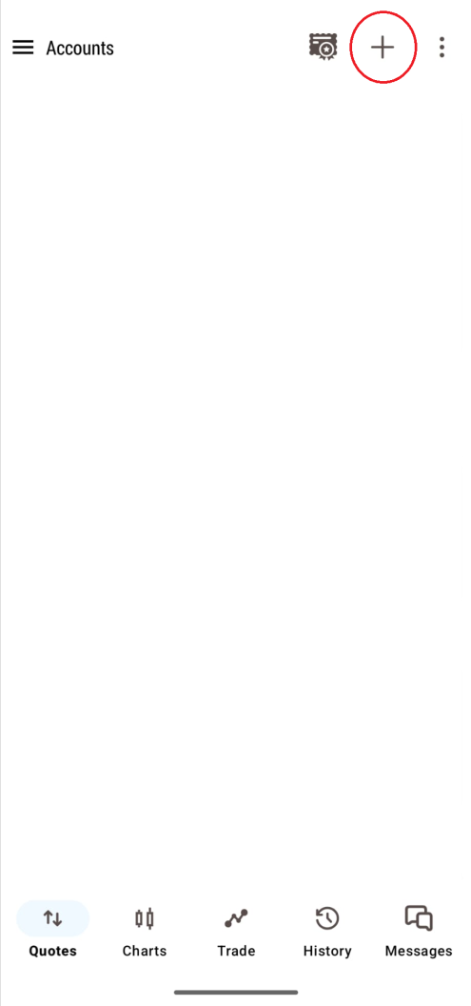
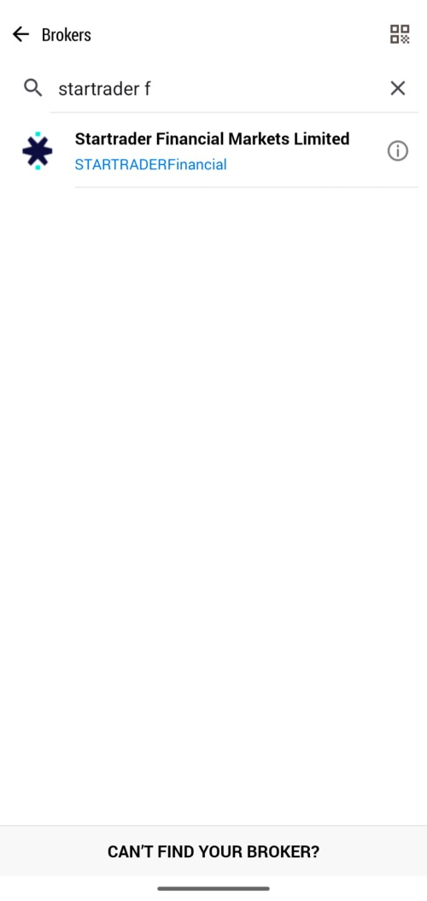
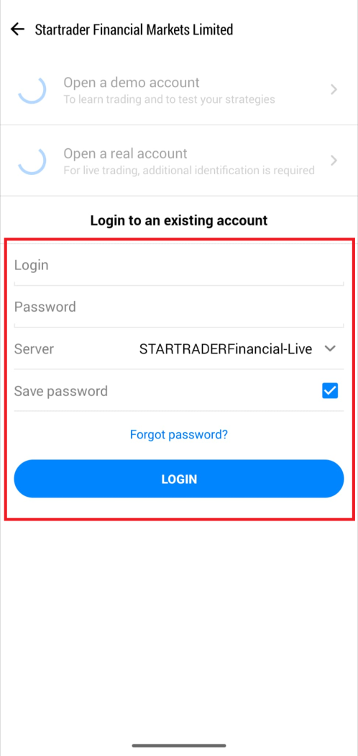
3. Click on the plus button at the top and search for ‘Startrader Financial’ and click on that which will bring you to your login details of your account (the email you received from Star Trader MT5 Login Details).

